Slide 1
Customer Segmentation Dashboard
Behavioral & Demographic Insights
Detailed Dashboard Explanation Presented by Mayank Gondaliya

Slide 2
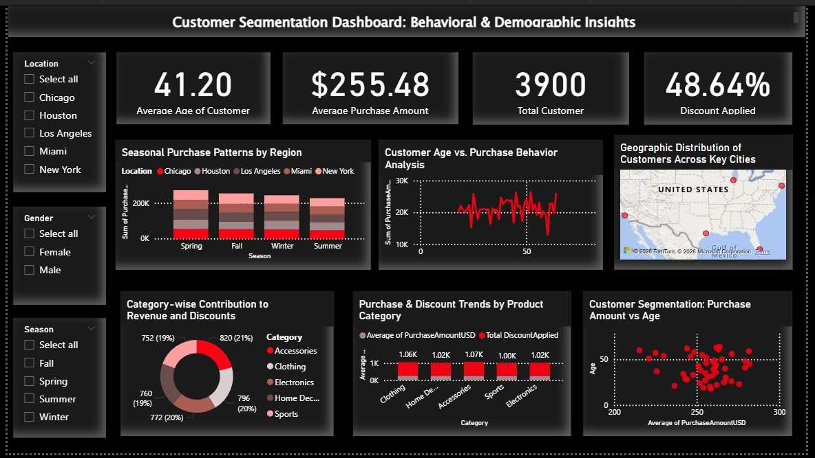
Complete Dashboard Overview

Slide 3
Key Performance Indicators (KPIs)
• Average Age of Customers: 41.20 years
• Average Purchase Amount: $255.48
• Total Customers: 3,900
• Discount Applied: 48.64%
These KPIs provide a high-level summary of customer demographics and purchasing behavior.

Slide 4
Seasonal Purchase Patterns by Region
This stacked bar chart shows how purchases vary across seasons and regions.
• Fall and Winter show higher purchase volumes.
• Chicago and New York contribute strongly across seasons.
• Helps plan seasonal marketing and inventory strategies.

Slide 5
Customer Age vs Purchase Behavior
This line chart analyzes how spending changes with age.
• Middle-aged customers (30–55 years) show higher spending.
• Indicates ideal age group for premium offers and loyalty programs.

Slide 6
Geographic Distribution of Customers
The map visual displays customer concentration across major US cities.
• Strong presence in New York, Chicago, and Los Angeles.
• Useful for regional sales planning and city- focused campaigns.

Slide 7
Category-wise Contribution to Revenue & Discounts
The donut chart represents revenue and discount contribution by category.
• Accessories and Clothing contribute the highest revenue.
• Balanced discount distribution across categories.

Slide 8
Purchase & Discount Trends by Product Category
This bar chart compares average purchase amount and total discounts.
• Electronics and Accessories have high purchase values.
• Sports category shows moderate discounts with stable revenue.

Slide 9
Customer Segmentation: Purchase Amount vs Age
The scatter plot identifies customer clusters.
• High-value customers are mainly between ages 30–50.
• Useful for targeted promotions and personalized offers.

Slide 10
Overall Business Insights
• Customers aged 30–55 are the most valuable segment.
• Seasonal demand peaks in Fall and Winter.
• Geographic concentration suggests scope for regional expansion.
• Category-level insights help optimize pricing and discount strategies.

